Slide 1
Exploring Mediating Factors in the Intergenerational Cycle of Obesity: A Systematic Review of Mediation Studies
Notes:
统一颜色 cite or free copyright

Slide 2

Background
There is consistent evidence showing intergenerational association of obesity
Children with parents who were overweight or obese were set to different
BMI growth trajectories at an early stage of life
The effect of maternal pre-pregnancy BMI on offspring adiposity was mainly through the direct effect or other pathways not investigated here
???Mediators
Maternal pre-pregnancy BMI
Offspring
BMI

Slide 3
Aims of the review
We aimed to summarize the current evidence on mediating factors that mediate the association between maternal pre-pregnancy BMI or obesity with that of their children.
Explore the mechanisms of the intergenerational transmission of obesity between parents, particularly mothers, and their children from a life course perspective.

Slide 4
Methods
Searches in PubMed, MEDLINE, Embase, Google Scholar. Human observational studies published in English and after 1980.
Inclusion criteria:
Studies reporting both the exposure variable (maternal pre- or early-pregnancy BMI, or overweight/obese status) and the outcome variable (offspring BMI or overweight/obese status)
Children aged <18 years old
Studies conducted mediation analyses and (reporting results from causal mediation analyses of factors on the causal pathway between maternal obesity and adiposity of the child)
Exclusion criteria:
children age >18 years
not full texts written in English
Subgroup analyses:
The subgroup analysis will stratify by child sex, or parents' BMI assessed time, and child's BMI assessed time

Slide 5
Results
Sample sizes ranged from 75 to 52,478 mother–child pairs
10 cohort studies, 3 cross-sectional studies
Regions: USA (7) Canada (1), Denmark (1), China (1), Australia (1), India (1), UK (1)

Slide 6
Study numbers by offspring age

Slide 7
Direct Acyclic Graph
Confounders
Birth weight (SGA, LGA)
Ponderal index
Head circumference
Birth length
Placental weight
Gestational weight gain
Gestational cardiometabolic disorders
Diet
PA
TV
Infant feeding
Birth mode
Exposure
Pre-pregnancy maternal BMI
Outcome
Offspring adiposity
Pre-pregnancy
Gestation
Postnatal
Childhood
Notes:
Each anthropometric index BMI-for-age, height-for-age, weight-for-age and weight-for-height may reflect a unique child nutrition status at specific ages.

Slide 8
Study | Mediators | Direct effect (95%CI) | Indirect effect (95%CI) | Total effect | PI
Danielle et al. 2021 | Birth weight* Birth length HC,PI, SGA, LGA | OR=1.68 (1.33-2.15) | OR=1.07(1.03-1.11) | 1.81(1.43-2.31) | 15.5% At age 2
Adane et al. 2019 | Birth weight | β=0.14 (0.06, 0.22) | β=0.06 (-0.02, 0.13) | β=0.20 (0.11, 0.28)
Michele J. Josey, 2019 | Gestational weight gain (GWG) | β=0.23 (0.16, 0.31) | β=0.02 (0.003, 0.04) | β=0.246(0.165, 0.329) | 8.1% At age 4
Zhang et al, 2021 | GWG, birth weight,the first-6-month ΔWAZ | β=0.0342(0.0302 to 0.0382) | β=0.0107 (0.0090-0.0125) |  | 25% At age 2
Babu 2022 | Gestaional diabetes | OR = 1.90 (1.16, 3.10) | OR = 1.16 (1.04, 1.30 | OR=2.20 (1.35, 3.58) | 25.2% of neonatal adiposity
Burgess 2021 | Added sugar | β=0.014(0.01) | β=0.006(0.00) | β=0.020(0.01) | 28% at age 6
Zhang 2023 | age of weaning | β=2.63 (2.27 ,2.99)** | β=0.02 (0.003, 0.042) | β=2.65(2.30,3.01) | 0.8% at age 17y
Notes:
Birth weight is confounder mediator

Slide 9
Summary
The natural direct effects were much stronger than the natural indirect effects
Birth anthropometry mediate the association between maternal pre-pregnancy overweight/obesity and offspring overweight/obesity in childhood and that the size of this mediated effect is small.

Slide 10
Quality assessment tool
ROBINS-E (Risk Of Bias In Non-randomized Studies - of Exposure)
https://www.riskofbias.info/welcome/robins-e-tool
7 Domains of bias:
Risk of bias due to confounding
Risk of bias arising from measurement of the exposure
Risk of bias in selection of participants into the study
Risk of bias due to post-exposure interventions
Risk of bias due to missing data
Risk of bias arising from measurement of the outcome
Risk of bias in selection of the reported result

Slide 11
Quality assessment tools
Mediation-specific biases
e.g., temporal order, mediator-outcome confounding bias
Notes:
Quality assessment practice in systematic reviews of mediation studies: results from an overview of systematic reviews
https://www.sciencedirect.com/science/article/pii/S0895435621004169

Slide 12
Characteristics of mediation quality assessment tools in the literature
Journal | First Author, Year | Format | Scope defined | OA* | Item & weights† | Scoring range‡ | SSI§ | Dev/Val/Rel‖ | Freq¶ | Details on the tool construction
Preventive Medicine | Lubans, 2008[16] | Scale | No | SS: 0-3: L; 4-6: M; 7-8: H | 8, BQ Equal | 0 – 8 | ND | NA | 1 | Proposed by the authors
Journal of Nutrition Education and Behavior | Cerin, 2009[17] | Scale | No | SS: 0-3: L; 4-6: M; 7-9: H | 9, BQ Equal | 0 – 9 | ND | NA | 1 | Modified from the tool of Lubans et al (2008)[16]
International Journal of Behavioral Nutrition and Physical Activity | Rhodes, 2010[18] | Scale | No | SS: 0-4: L; 5-8: M; 9-11: H | 11, BQ Equal | 0 – 11 | ND | NA | 4 | Adding into the tool by Lubans et al[16] three additional items proposed by Cerin et al[17].
International Journal of Obesity | van Stralen, 2011[19] | Scale | No | PS: 0-70%: L; 70-100%: H | 10, BQ Equal | 0 – 100% | ND | NA | 1 | Combining the checklist of Lubans et al[16] and Cerin et al[17] and criteria proposed in a Delphi-based criteria list for QA of RCTs
Best Practice & Research: Clinical Rheumatology | Mansell, 2013[20] | Check-list | No | - | 12, BQ - | - | - | NA | 1 | Adapting the tool of Lubans et al[16], Cerin et al[17] and Rhodes et al[18] by adding some new items recommended in the literature, following a methodological (non-systematic) review that they conducted.
Clinical Psychology Review | Gu, 2015[21] | Scale | No | SS: 0-5: L; 6-11: M; 12-16: H | 16, BQ Equal | 0 – 16 | ND | NA | 1 | Adapting the tool of Lubans et al[16] by the CONSORT checklist, the Jadad checklist and Kazdin (2007)’s design requirements for mediation
Pain | Lee, 2015 | Scale | No | SS: No rule for conclusion | 7, BQ Equal | 0 – 7 | ND | NA | 2 | Modified from the tool of Mansell et al[20]
 | [22]
British Journal of Health Psychology | Windgassen, 2017[23] | Scale | No | SS/PS No rule for conclusion | 8, BQ Equal | 0 – 8/ | ND | NA | 1 | Adding into the tool of Lubans et al[16] some items based on the standards of MA proposed by MacKinnon (2008)
 |  |  |  |  |  | 0 – 100%
Clinical Psychology Review | Hoppen, 2018[24] | Scale | No | SS/PS No rule for conclusion | 12, MCQ Unequal | 0 – 40/ 0 – 100% | ND | NA | 1 | Proposed by the authors
Clinical Psychology Review | Williams, 2018[15] | Domain-based | No | NA | 7, DM - | NA | ND | NA | 1 | Adapted from the Effective Public Health Practice Project tool (EPHPP; Thomas, 2003)
Appetite | Claassen, 2019[25] | Scale | No | SS: D3-4/M3-5: B D2-M3-5 or D3-4/M2: M Otherwise: L | 2, MCQ Equal | 2 – 9 | ND | NA | 1 | Proposed by the authors
PloS One | Cortés Garcías, 2019 [26] | Scale | No | SS: 0-4: W; 5-7: M; 8-9: S | 9, BQ Equal | 0 – 9 | ND | NA | 1 | Adapted from the tool by Lee et al [22] with four items added in view of ‘standard guidelines’ for QA of RCTs and observational studies

Slide 13
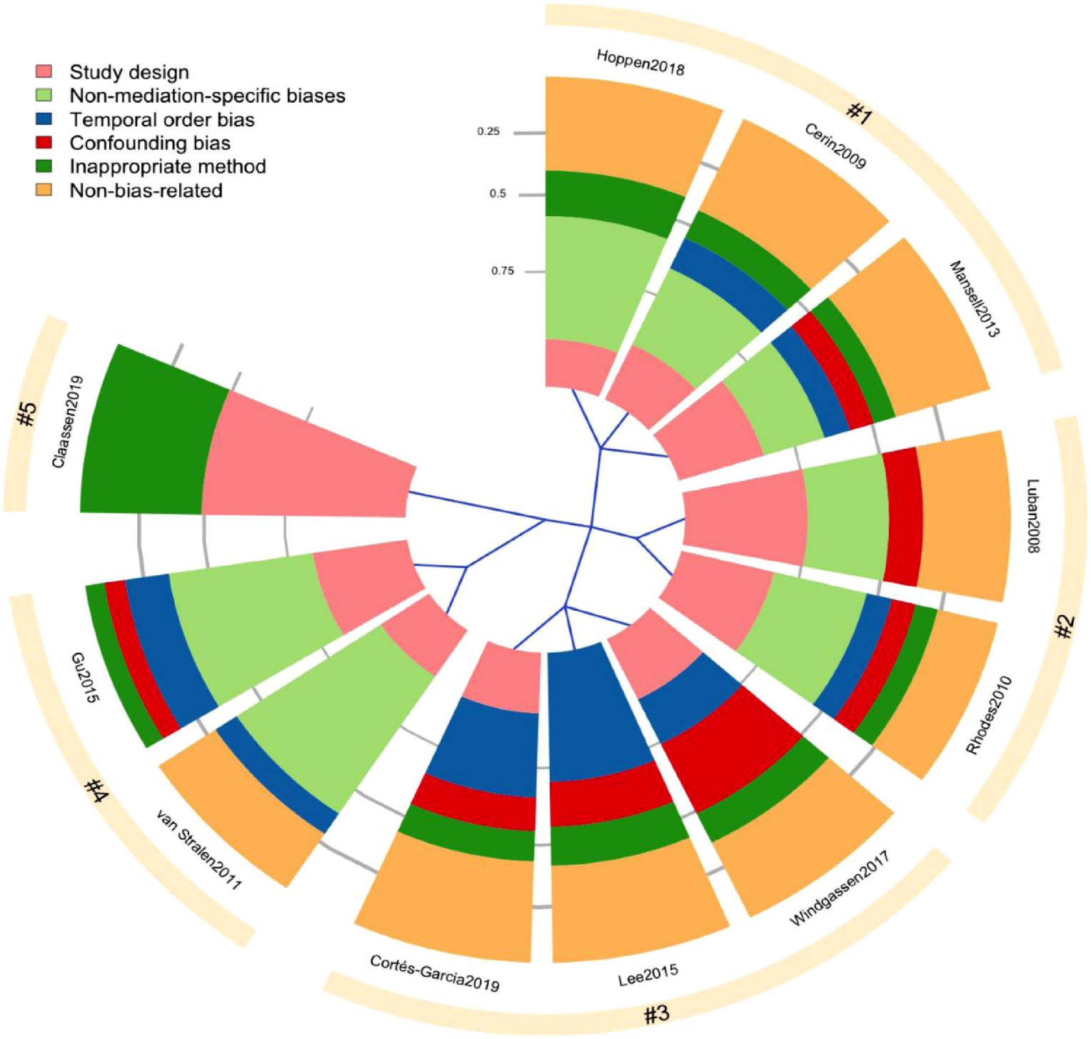
Fig. Hierarchical clustering of 11/12 tools based on the six quality domains.

Slide 14
Example: checklist for measuring study quality
Items | Yes | No
Is there hypothesis/aim/objective of the study clearly described? (Objectives are formulated adequately: precise, clear and comprehensive)
2. Is the study design appropriate to objectives?
3. Is the study sample representative? (Participants are recruited from a representative setting that relates to the studies aims and hypotheses)
4. Were the psychometric characteristics of the mediator and outcome variables reported? (Computed from the present study or a reference provided)
5. Were statistically appropriate/ acceptable methods of data analysis used? (This includes the product of coefficient approach with bootstrapped confidence intervals, structural equation modelling, latent growth modelling, and causal mediation analysis)
6. Did the study ascertain whether changes in the mediating variable preceded changes in the outcome variable?
7. Did the study ascertain whether changes in the predictor variable preceded changes in the mediator variable?
8. Are the main findings of the study clearly described? (Simple outcome data should be reported for all major findings so that the reader can check the major analysis and conclusions)
9. Did the study control for possible confounding factors? (Variables that may impact on results are identified and controlled for in terms of statistical analysis)
Notes:
https://journals.plos.org/plosone/article?id=10.1371/journal.pone.0213099#pone.0213099.s001

